Slide 1
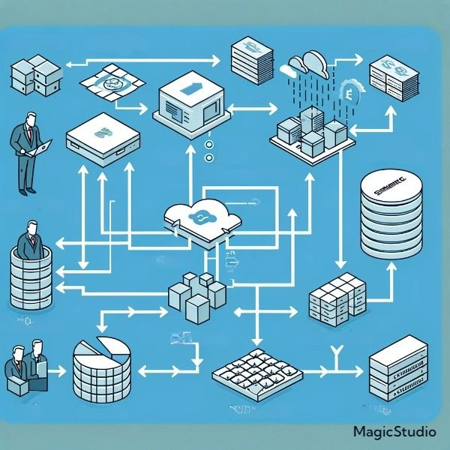
FARMER PROFILES
DATA SOURCES
DATA CONTRACT INTEGRATIONS
ETL
DATA STORAGE
PRODUCT TRANSACTION RECORDS
DATA INTEGRATION LAYER
DATA PROFILES
DATA READERS
DATABASE
MIDDLEWARE
SQL
DATA STORE
DATA STORAGE
DATA WAREHOUSES

